Slide 2
Michael Niehaus
Programme Director, 2Pint Software michaeln@2pintsoftware.com
2x ex-MVP
Linux for the Windows admin
“How different can it be?”

Slide 3
Linux 101

Slide 4
Linux quick history
1991: Started by Linus Torvalds
1992: Released under the GPL open-source license
1993: Distributions started appearing
1994: Linux 1.0 released, commercial distributions from Redhat and SUSE started
1999: RedHat Linux 6.0 made Linux more popular in the enterprise
2004: Ubuntu distribution launched
2009: Linux kernel used as the basis for ChromeOS
2013: Linux kernel used as the basis for Android
2013: Steam OS based on Linux (“runs Windows games better than Windows”)
2026: Now up to Linux kernel 7.0

Slide 5
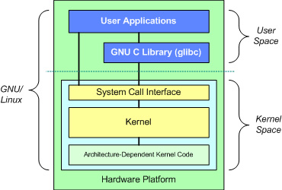
Linux architecture
Monolithic kernel
  Tightly controlled, still managed by Linus Torvalds (“benevolent dictator”)
Many packages layered on top of the kernel:
  System libraries (APIs)
  Shells
  Desktop environments (UI, optional)
  Utilities and apps, including a package manager
  No central control
  Yes, even the kernel is updated via a package
Learn more from https://linuxfoundation.org and other sources

Slide 6
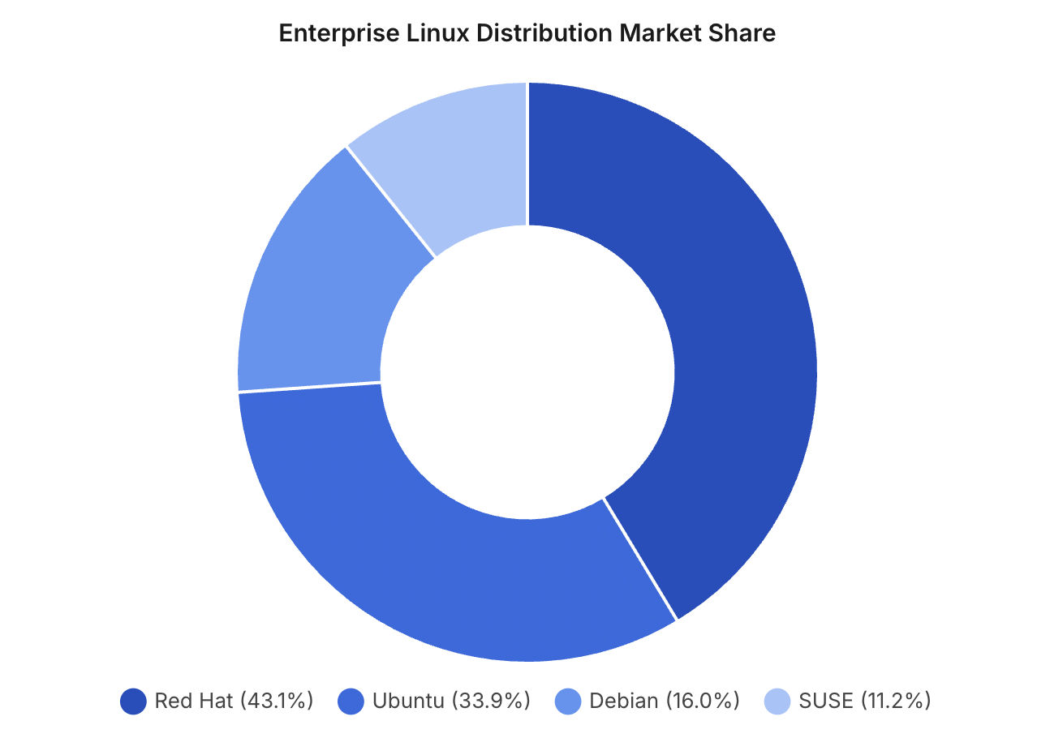
What is a Linux distribution?
Standard Linux kernel (usually)
Layer of packages
  There are alternatives for nearly every component: shells, desktop environments, commands, etc.
  A distribution expresses preferences, which can always be customized
  Drivers are generally preinstalled (mostly)

Slide 7
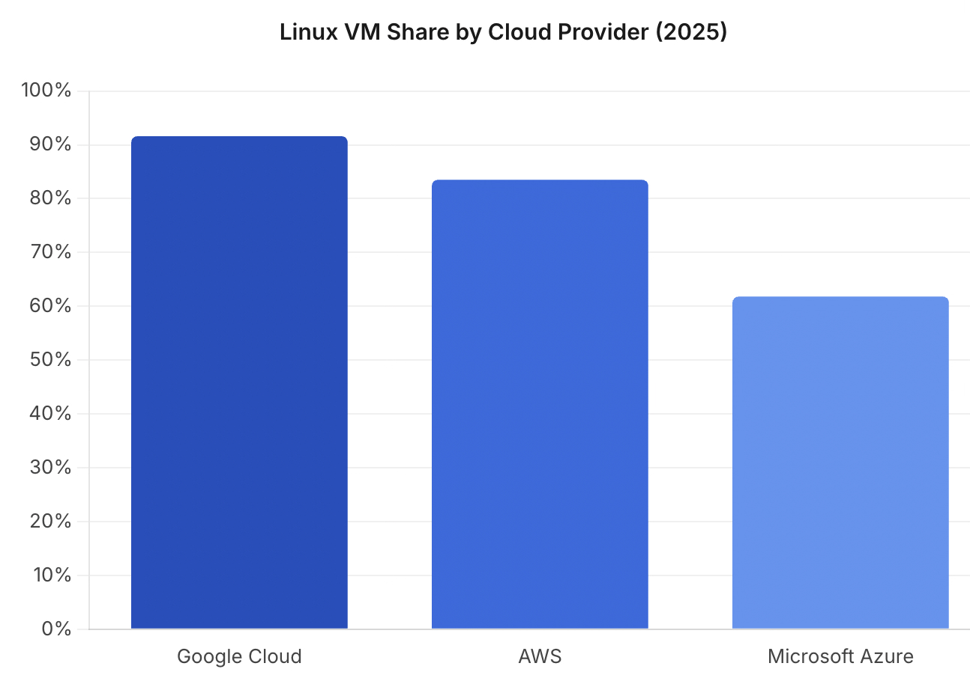
Linux server vs. desktop
The main differences between Linux servers and desktops:
  Command line vs. UI
  Workloads (obviously)
Primary desktop uses:
  Developers
  “Sovereign alternative”?
  Thin clients (IGEL, UniconOS/eLux, etc.)
  Digital signage
Over 50% of servers run Linux (even higher with cloud VMs)
Around 4% of desktops

Slide 8
Let’s talk about file systems…
Generally supported for installs:
  XFS
  ZFS
  Ext4 (and maybe 2 and 3)
  Btrfs
Accessible:
  NTFS
  FAT32/exFAT
  FAT
Different distros have their own preferred defaults:
  Redhat uses XFS
  Ubuntu uses ext4
  OpenSUSE uses Btrfs

Slide 9
…and disk encryption
LUKS is the equivalent of BitLocker
  Full disk encryption
  Prompt for PIN or use TPM (supports more than one PIN, e.g. a user PIN and a helpdesk PIN)
  Best to do at install time, more challenging to add later
Defaults are typically sufficient on current releases:
  AES-XTS for the data cipher
  512-bit XTS key
  Argon2id for passphrase stretching

Slide 10
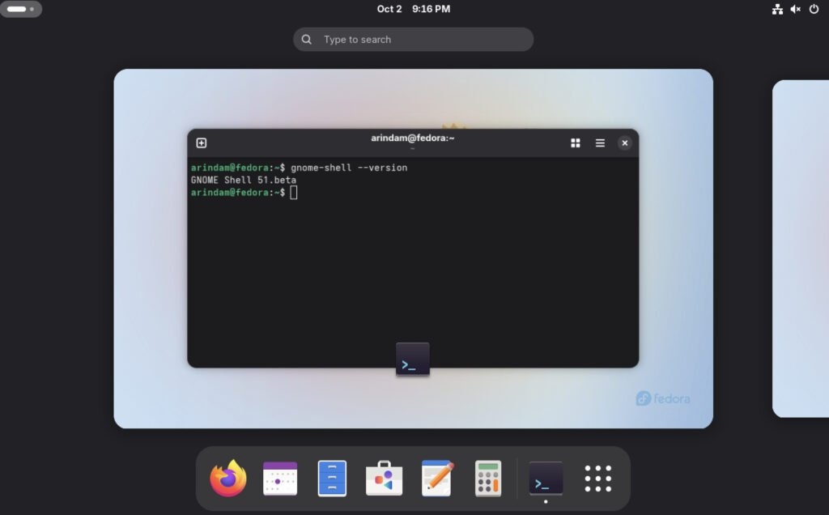
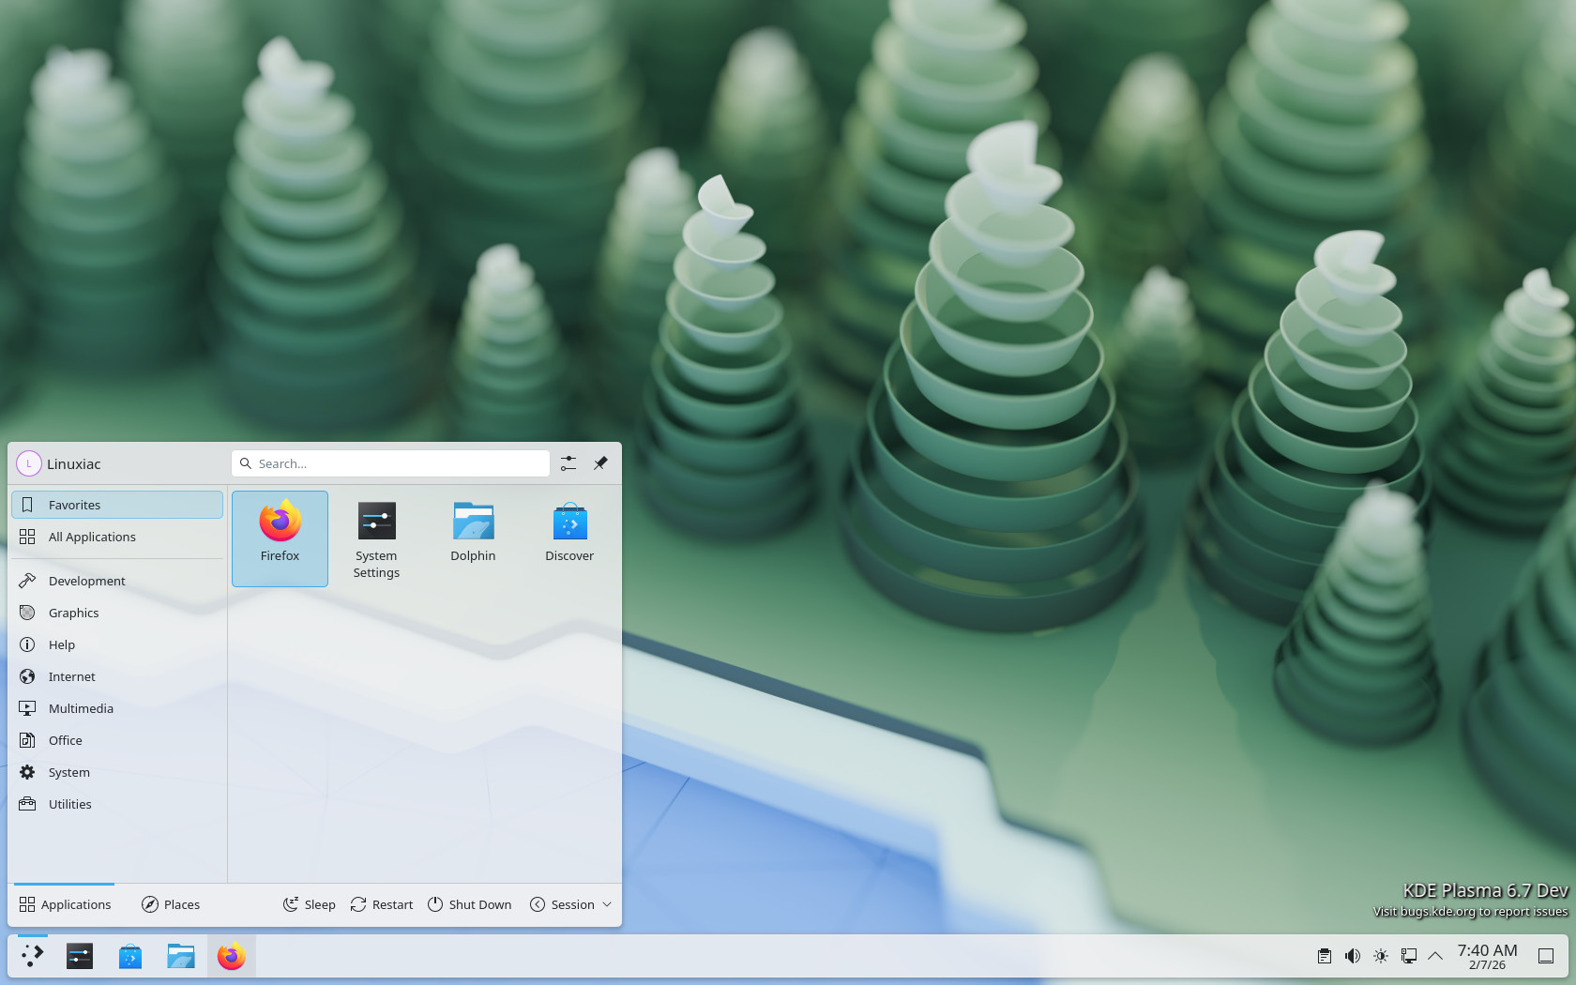
…and desktop environments
Gnome
  Default for Redhat, Ubuntu
KDE
  Default for OpenSUSE

Slide 11
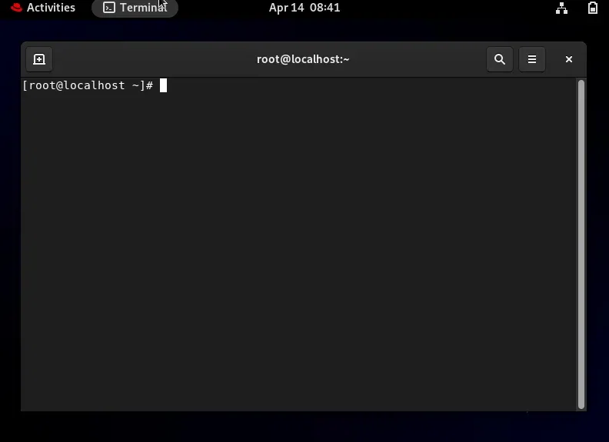
..and shells
Bourne Shell (sh)
Bourne‑Again Shell (bash)
C Shell (csh)
Korn Shell (ksh)
Z Shell (zsh)
Fish (Friendly Interactive Shell)

Slide 12
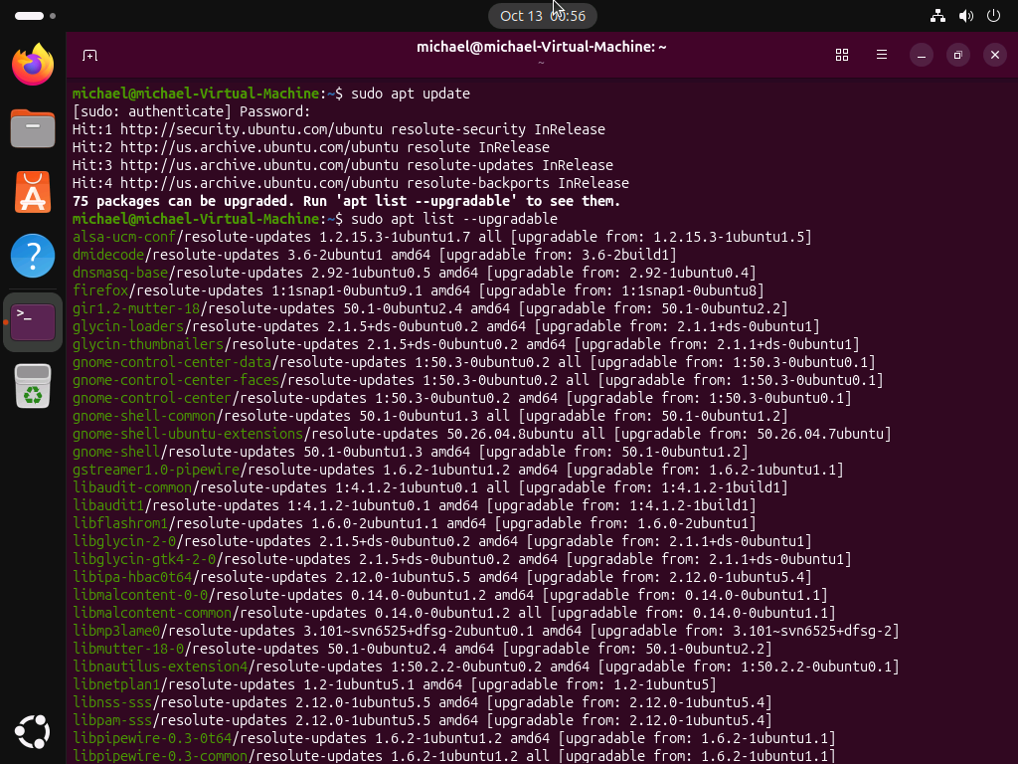
…and package managers
DNF / .rpm
  Used with Redhat
APT / .deb
  Used with Ubuntu
YaST / Zypper / .rpm
  Used with OpenSUSE

Slide 13
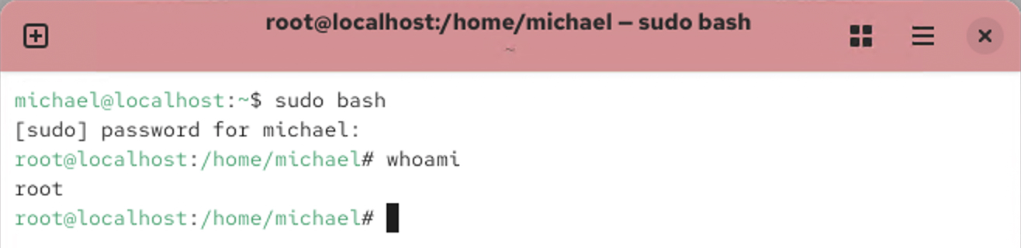
..and sudo
If you need to make changes to anything (outside of your own user account), you will need to elevate
sudo provides the ability to elevate to root

Slide 14
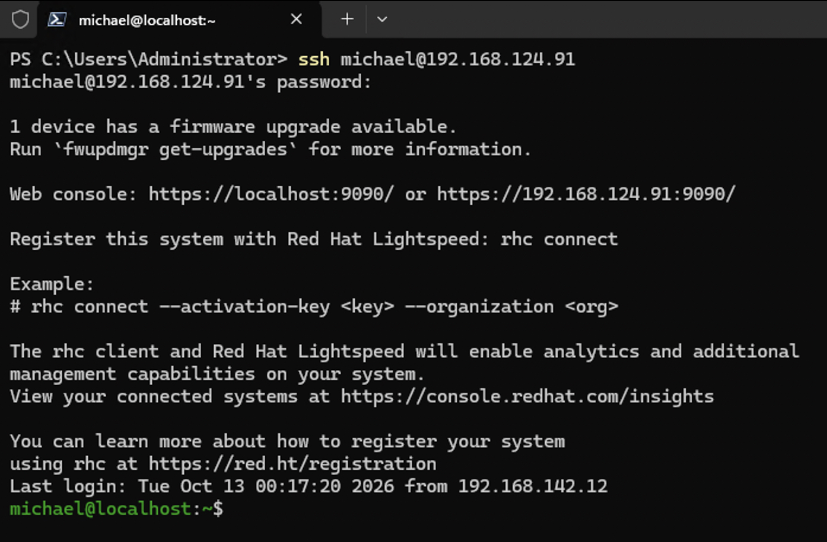
What about remote administration?
Top choice: SSH
  Typically uses keys for authentication: Generate on the client, register on the server
  Use the built-in SSH client in Windows 11
Also possible (for desktops at least):
  RDP
  VNC

Slide 15
There are lots of choices…
Start (and perhaps stay) simple:
  Let the distribution you use determine your choices
  Stick with defaults
  Tweak if necessary
Add on top (e.g. additional packages and apps)
  SMB, CIFS for interaction with Windows devices
  Chrome if you don’t want Firefox

Slide 16
The Linux PC lifecycle

Slide 17
Let’s start with the lifecycle of a PC
Deploy
OS install
Manage
Configuration
Repurpose/Dispose
Erase
OS provisioning/configuration
Control
Update
Install more stuff
Reimage
Authenication

Slide 18
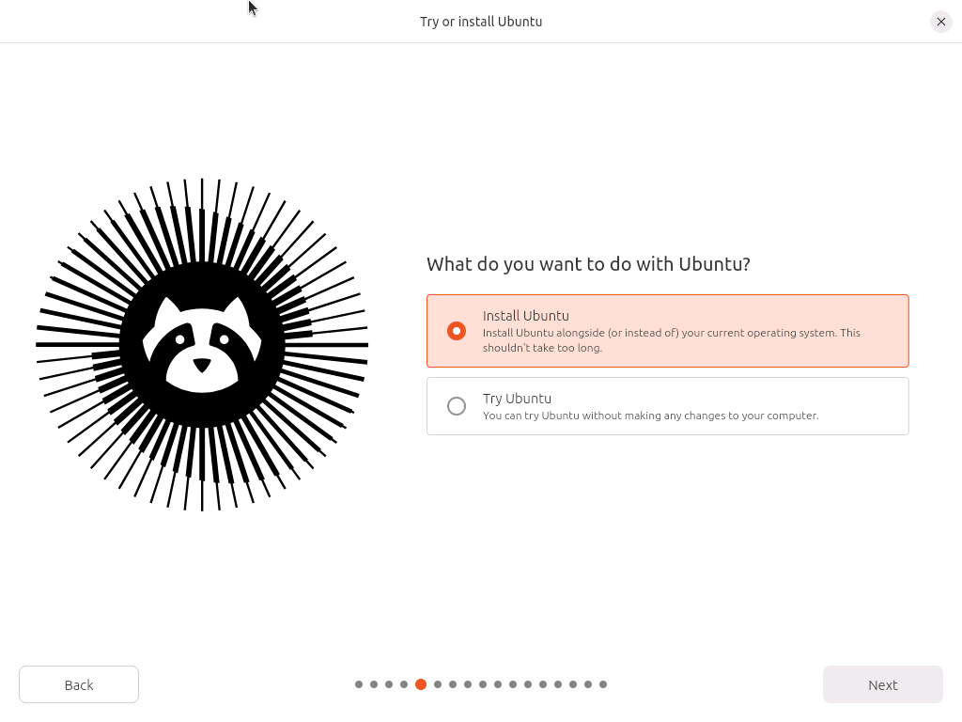
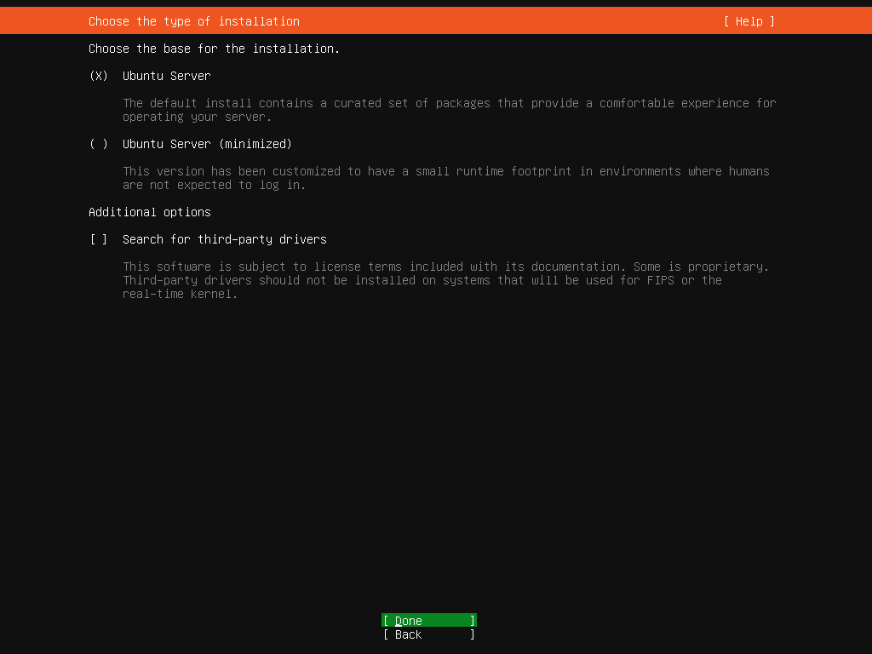
Deploying Linux
Yes, you can use an ISO and do an interactive install
  Generally, GUI-based for desktops, text-based for servers
  Distros use different installers (of course they do)
Great for one-offs…

Slide 19
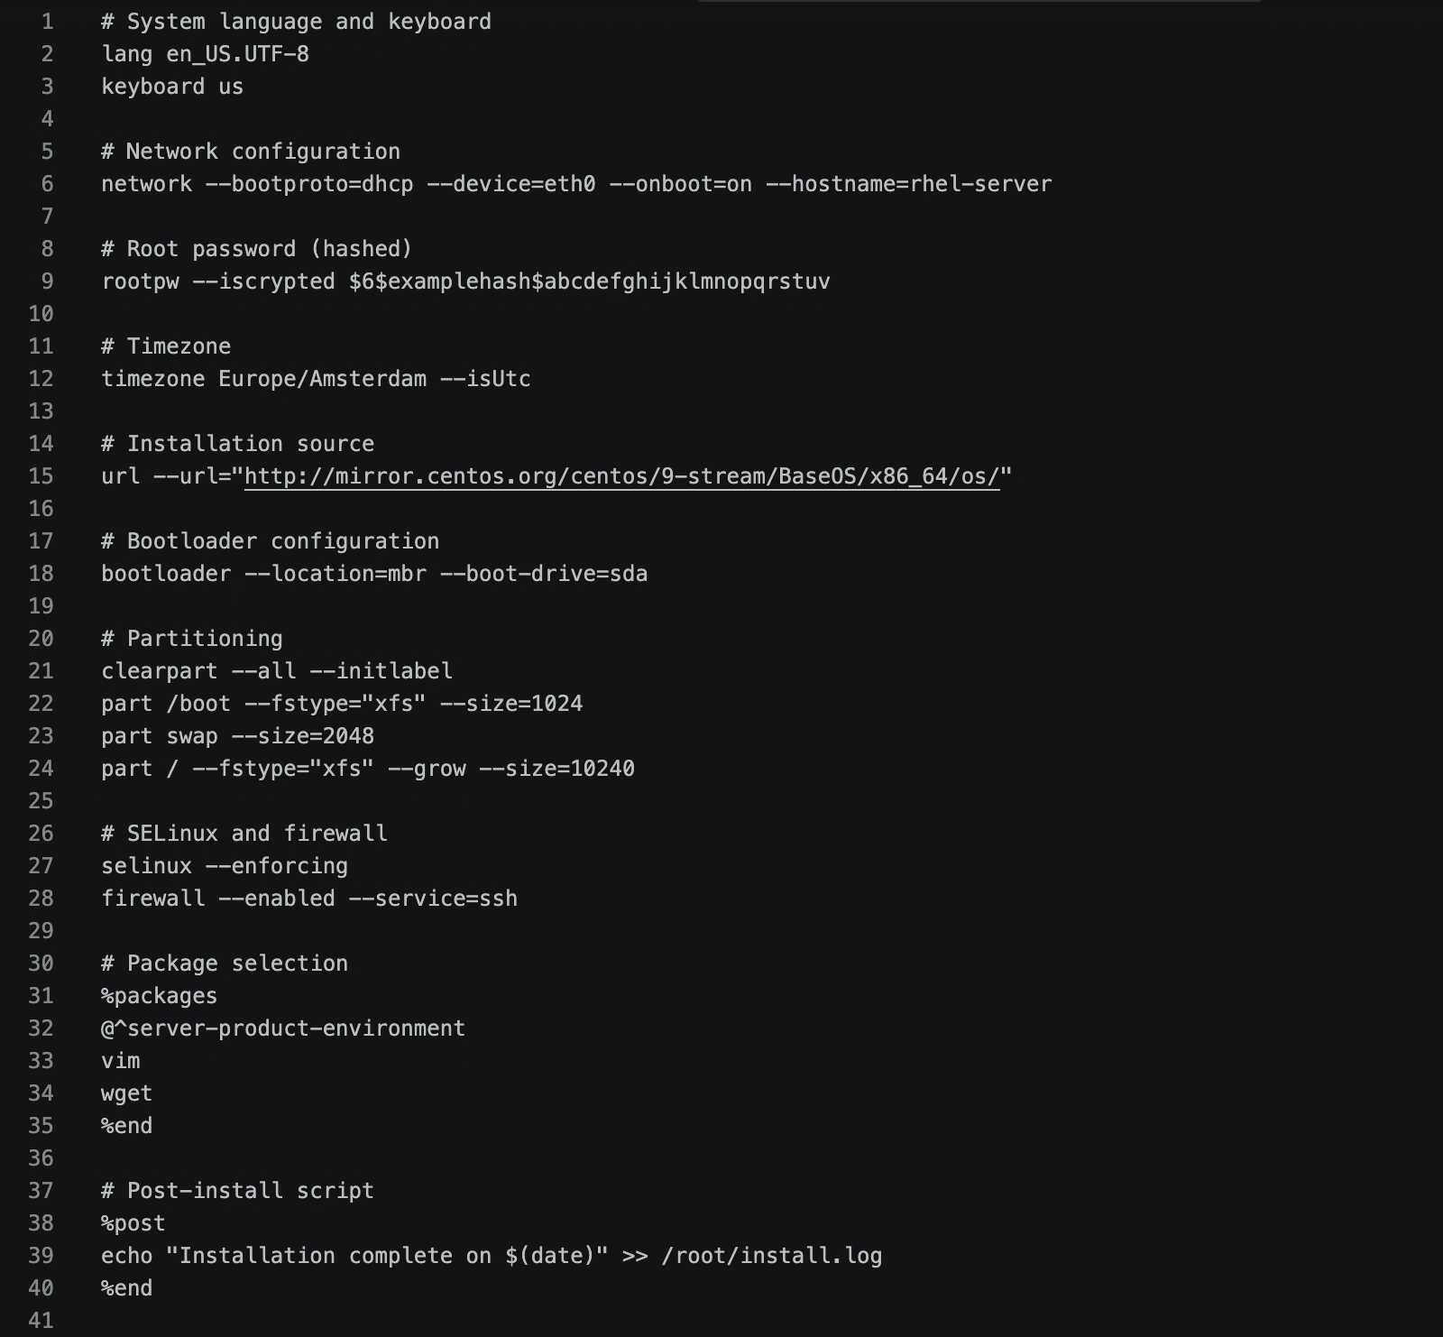
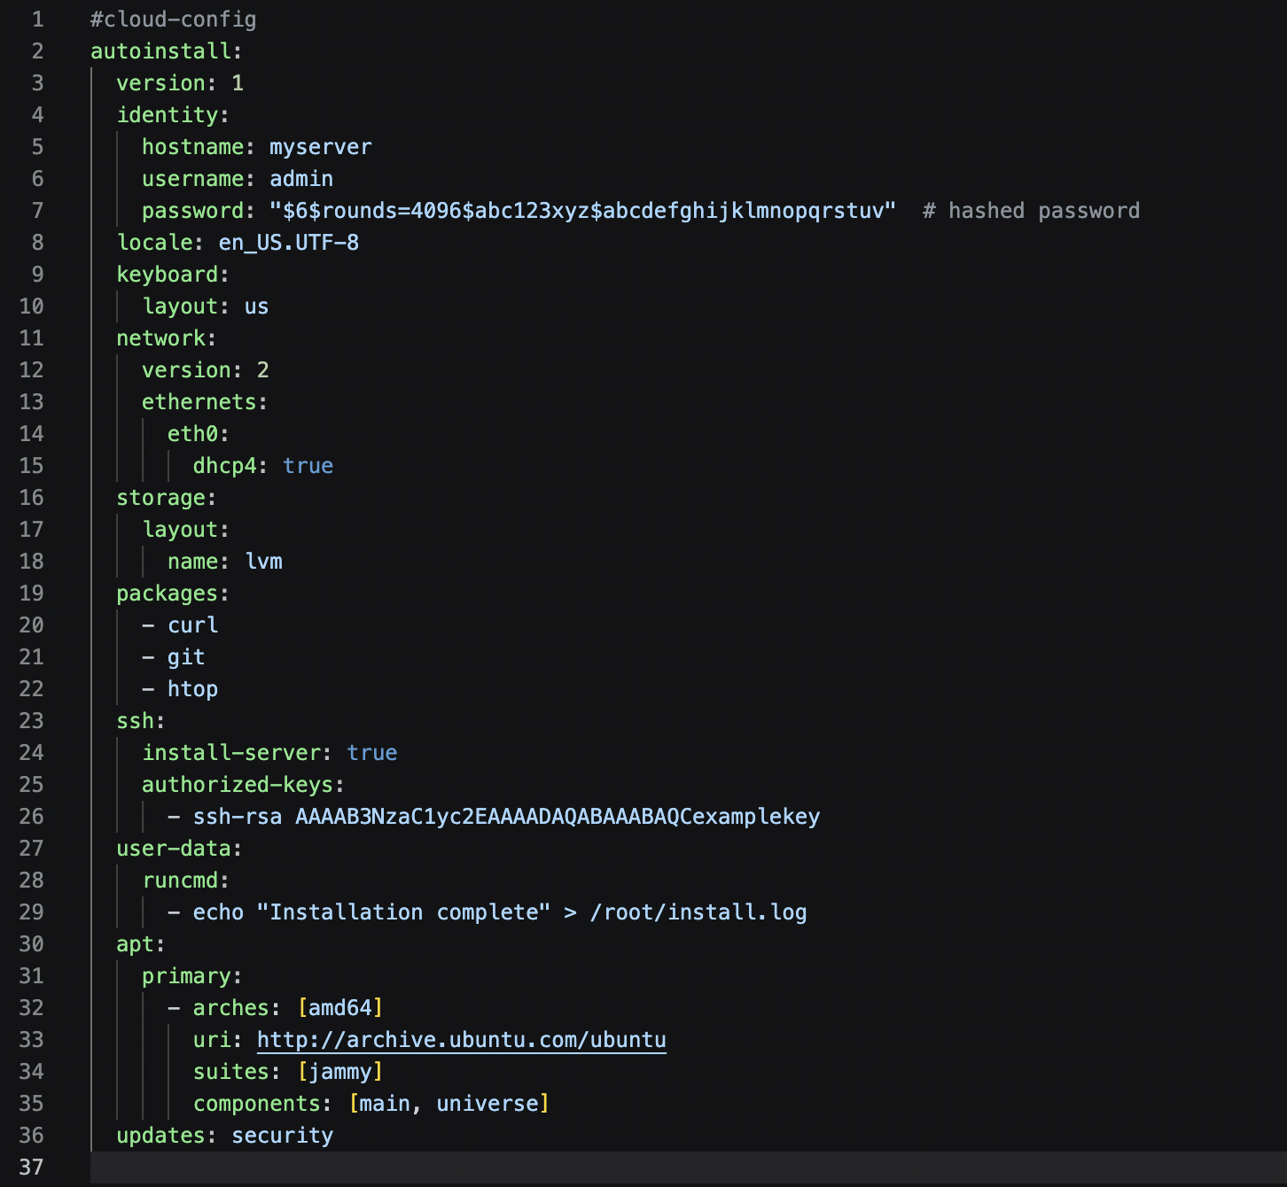
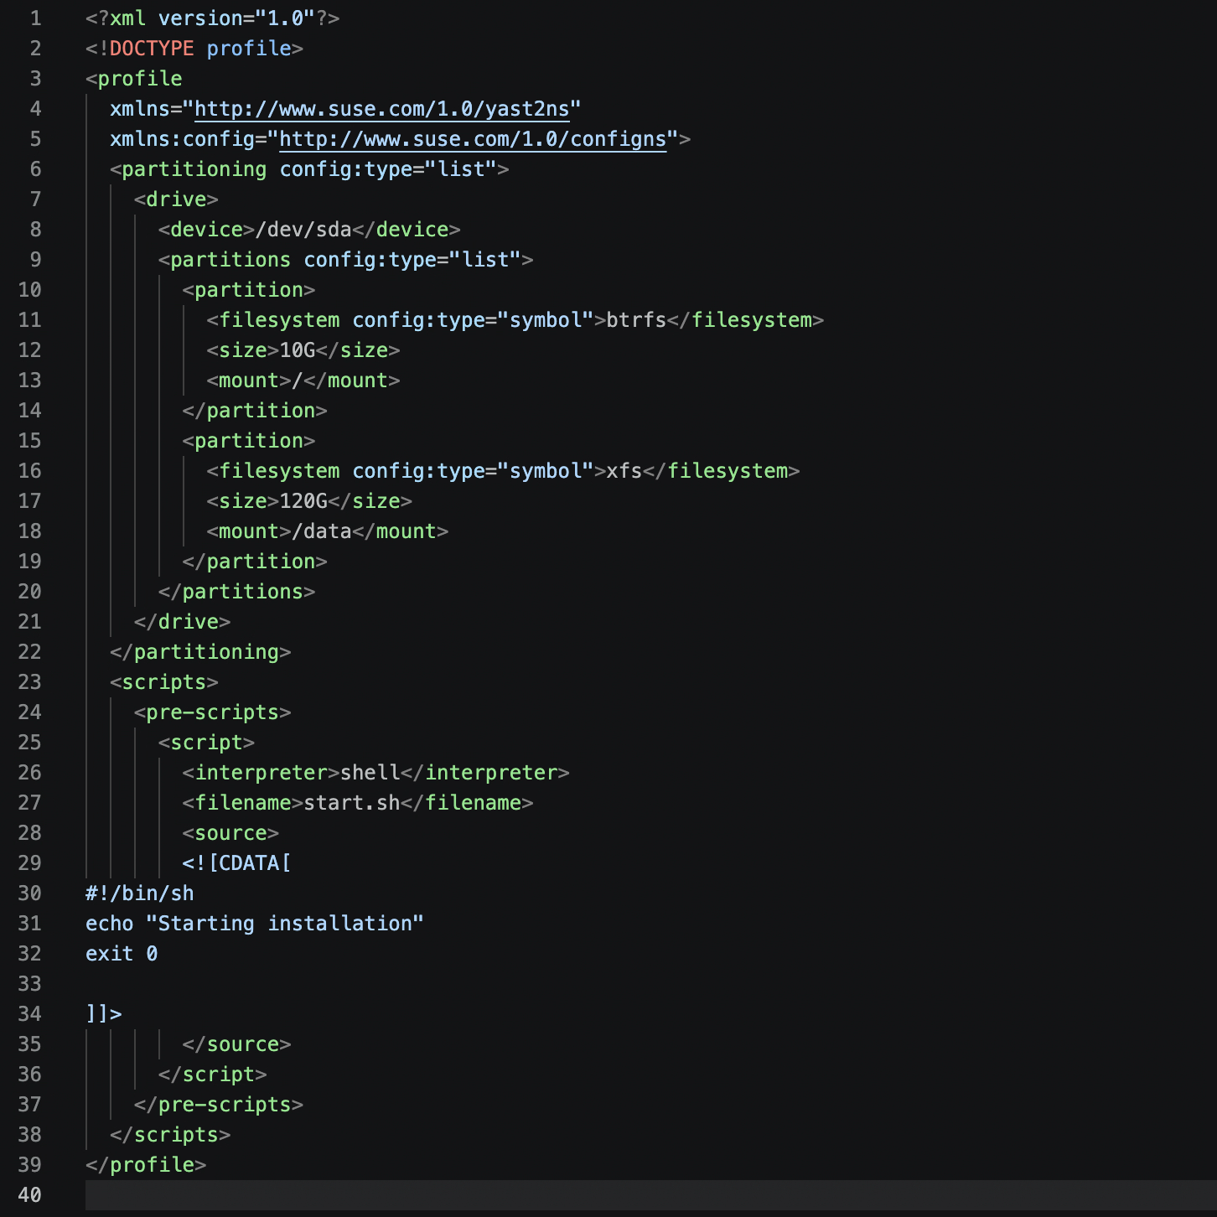
Unattended installations
Redhat (and family):
  Anaconda with Kickstart scripts for automation
Ubuntu:
  Subiquity installer with Autoinstall answer file
OpenSUSE:
  AutoYaST installer with control file

Slide 20
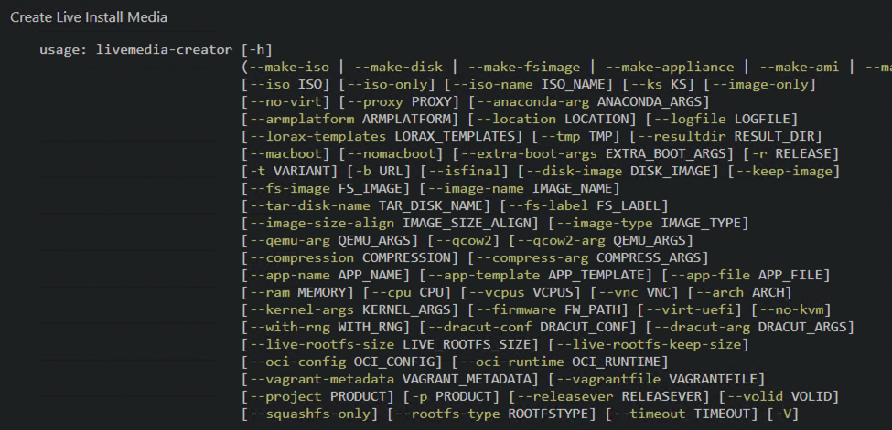
What about ”something like Windows PE”?
You can create custom “live” Linux images that run from a RAMdisk
  Fedora (Redhat) is a popular choice
  livemedia-creator to help limit what is included
  Boot via PXE or media

Slide 21
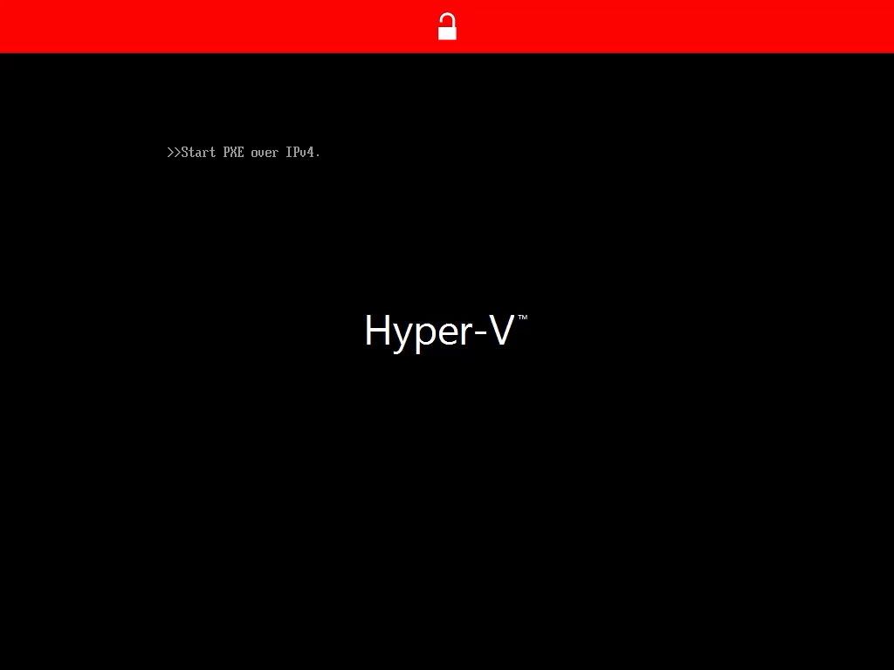
Unattended installation

Slide 22
What about image-based deployments?
There are a variety of imaging tools (no surprise there) to capture and restore:
  Partclone
  Partimage
  FSArchiver
  dd (ick)
  Clonezilla (more of a wrapper over the tools)
  FOG Project (a wrapper too, but also more of a full deployment solution)
Images are pre-built for VMs, containers, etc. but not for physical devices
Some file systems don’t play well with some imaging tools (e.g. Btrfs)
Sector-based images create some challenges
There’s no “Sysprep” for Linux, but there is an equivalent that does more…

Slide 23
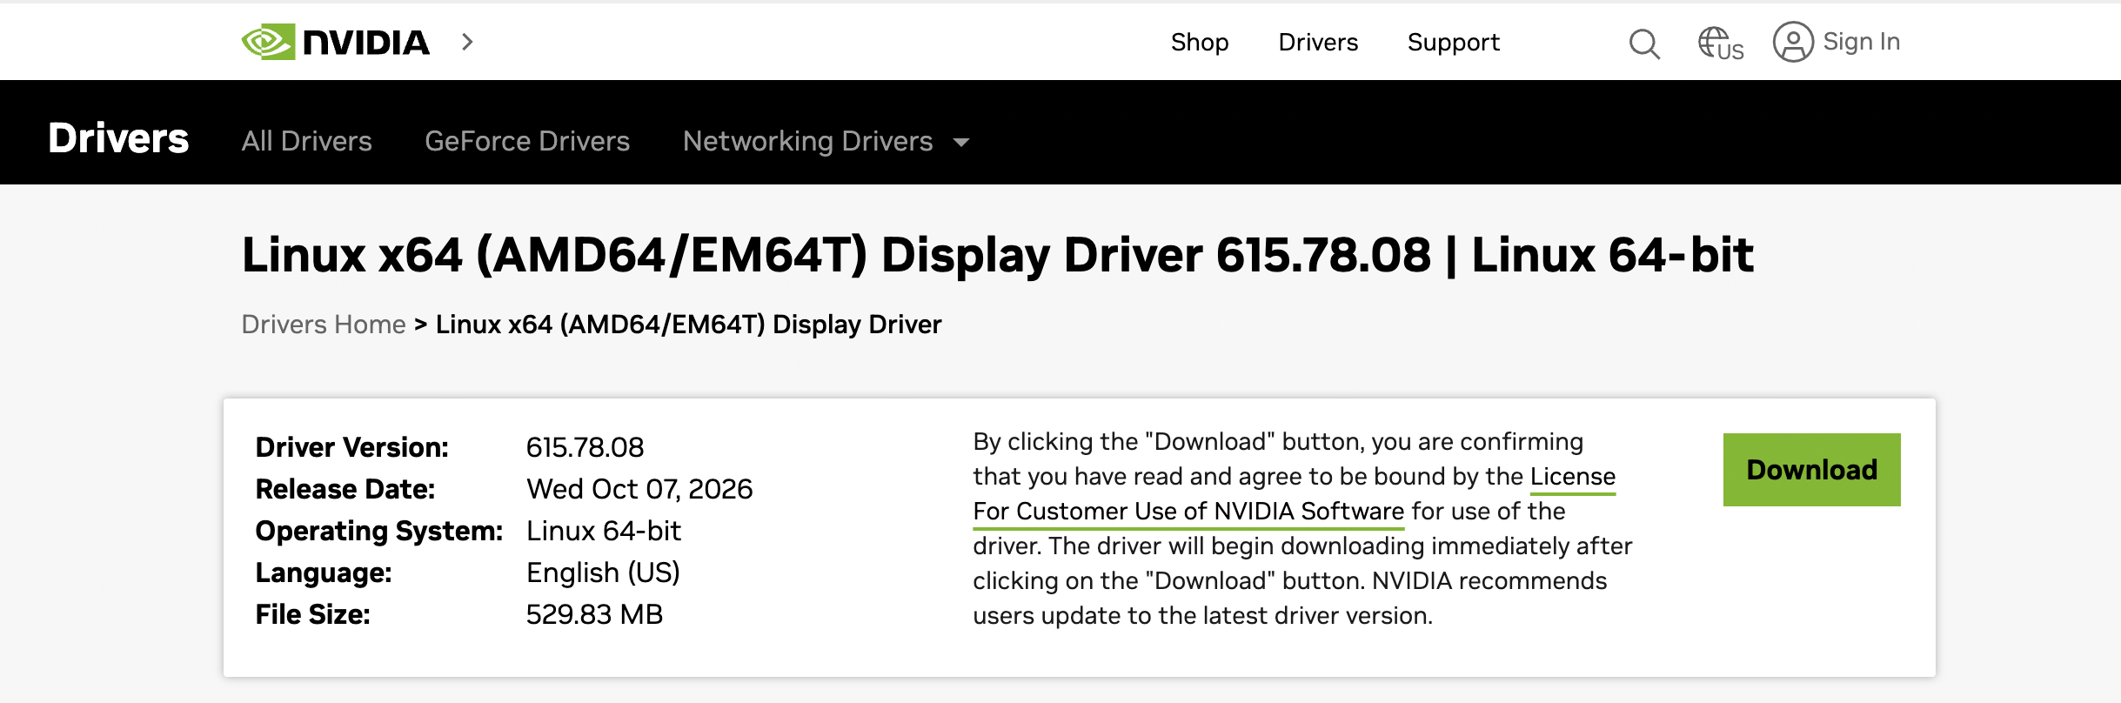
What about drivers?
Most are installed by default
  Exceptions: anything closed-source, e.g. video drivers
  It may be necessary to add additional repositories to pull from
There are still challenges:
  initrd

Slide 24
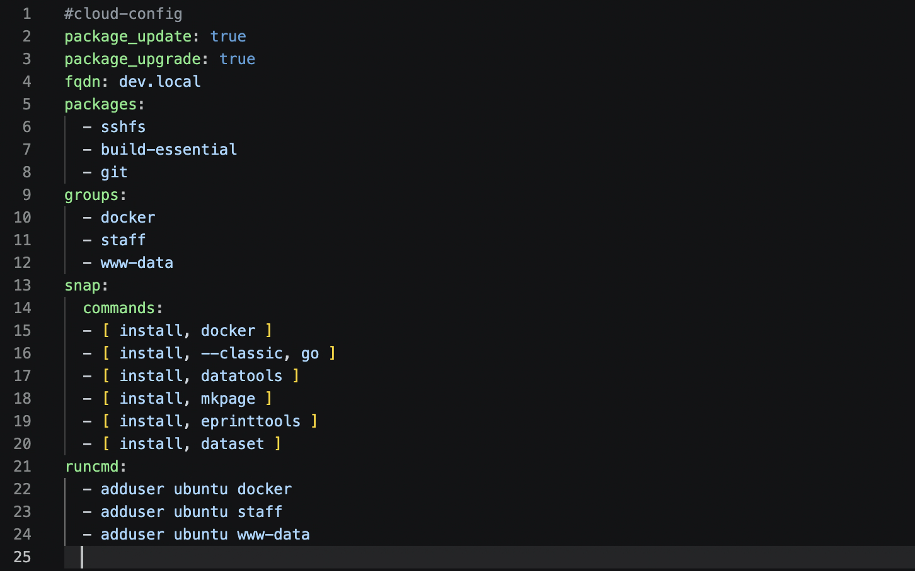
What about after the OS is installed?
Each installer provides a way to run things once in the new OS (via chroot too)
But for consistency, you can use cloud-init, even when not in the cloud
And that’s a cool thing…
  Runs once on each new device
  Handles typical configuration tasks
  Same thing used with new cloud VMs

Slide 25
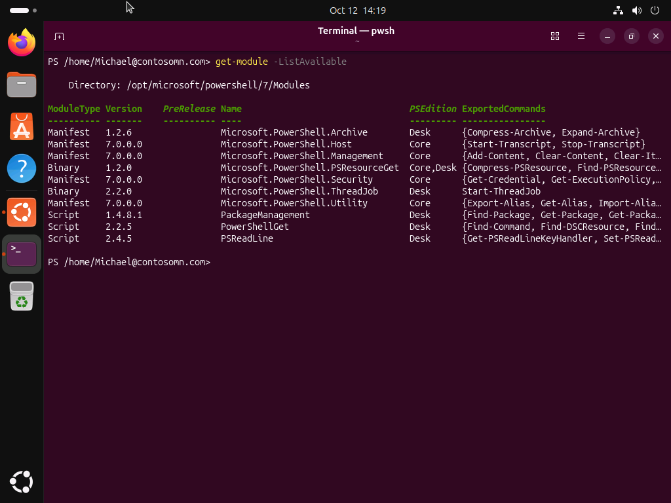
What about PowerShell on Linux?
Great to have, but OS-related cmdlets are few
  Linux admins prefer command-line tools
  PowerShell Crescendo for wrapping commands is possible, but hasn’t gained popularity

Slide 26
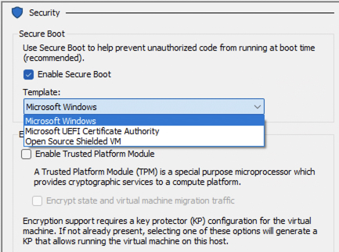
What about Secure Boot?
Linux fully supports Secure Boot
  Secure Core PCs only enable Windows by default, so tweak the firmware settings
  Hyper-V allows “either” Windows or Linux, but not both (turn off Secure Boot as a workaround)
  Read up on shim.efi, moq, etc. (but it’s usually easy)

Slide 27
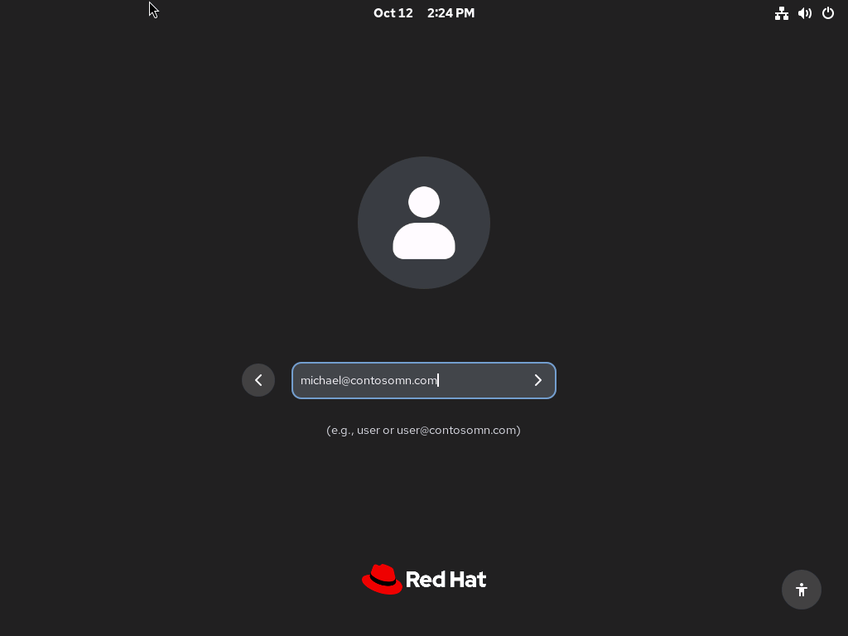
What about authentication?
NIS+
  Old Sun protocol, out of favor
LDAP
  Commonly used
Active Directory
  Full Kerberos support
  Even some GPO/ADCS support
Entra ID
  Using PAM AuthD or LDAP
Google accounts
  Using PAM

Slide 28

What about authentication?
NIS+
  Old Sun protocol, out of favor
LDAP
  Commonly used
Active Directory
  Full Kerberos support
  Even some GPO/ADCS support
Entra ID
  Using PAM AuthD or LDAP
Google accounts
  Using PAM

Slide 29
What about management?
Clients:
  Pets
  Roaming devices
  Intune
  Omnissa Workspace ONE
Servers:
  Cattle
  ”Infrastructure as Code”
  Well-connected devices
  Puppet
  Chef
  Ansible

Slide 30
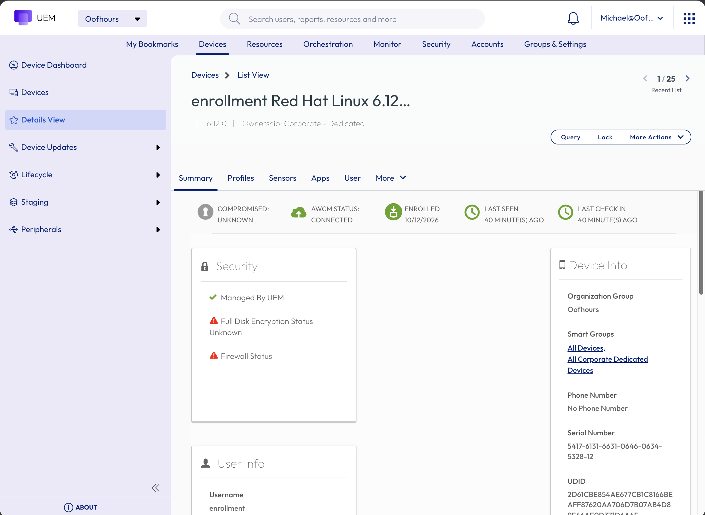
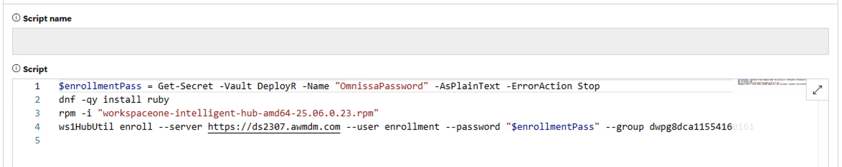
Workspace ONE
Enrollment can be completely automated

Slide 31
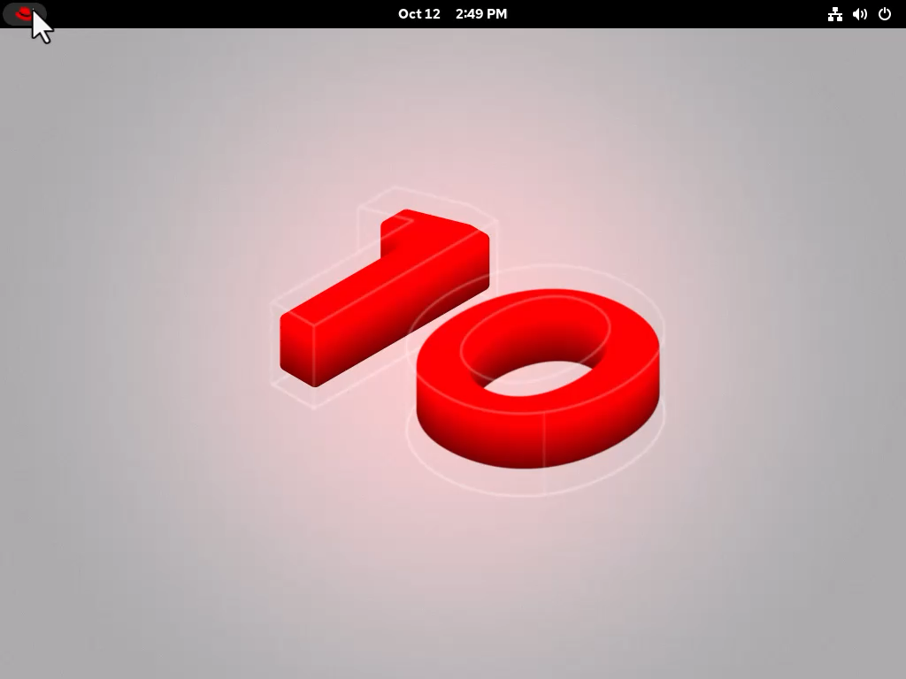
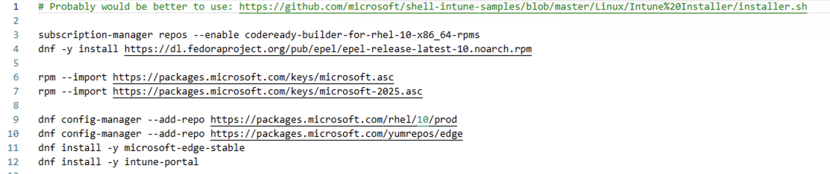
Intune
Needed packages can be automatically installed
User completes the enrollment manually
  No bulk enrollment support

Slide 32
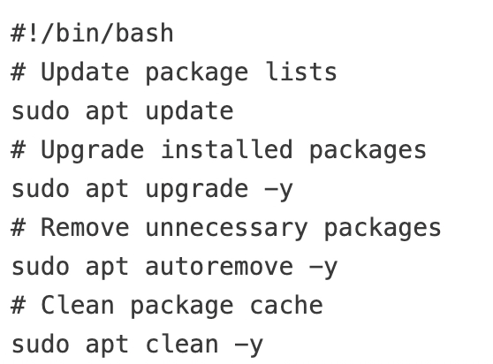
What about patching?
Fairly straight-forward:
  Using the package manager to update to the latest(–ish) packages
  Upgrading to later versions
  Upgrading apps
  Easy for management tools to handle

Slide 33
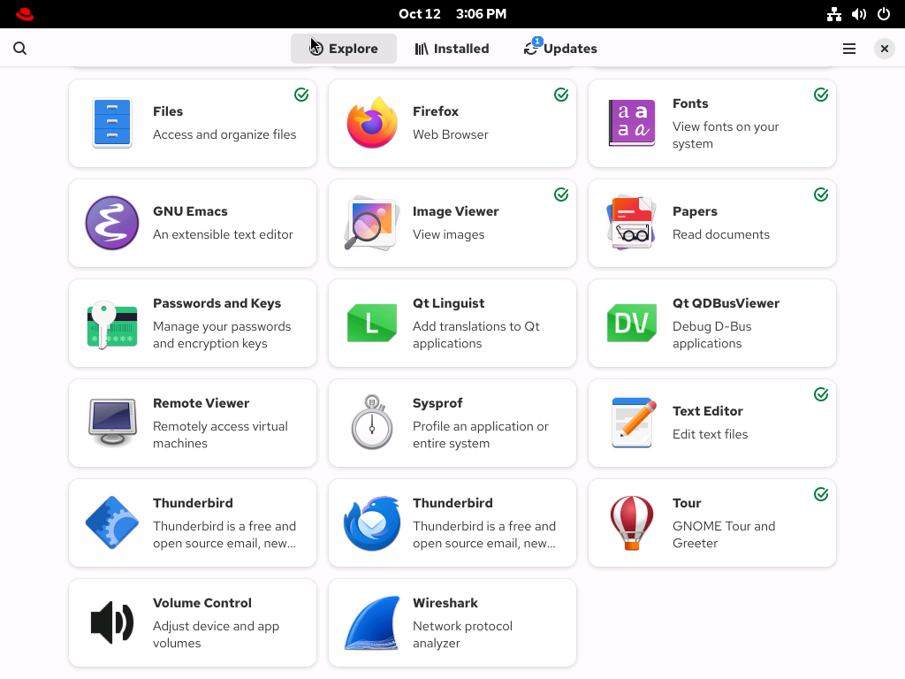
What about apps?
Apps can be delivered in different ways
  Packages
  Flatpacks
    Redhat-sponsored
  Snaps
    Ubuntu-sponsored
  Homebrew

Slide 34
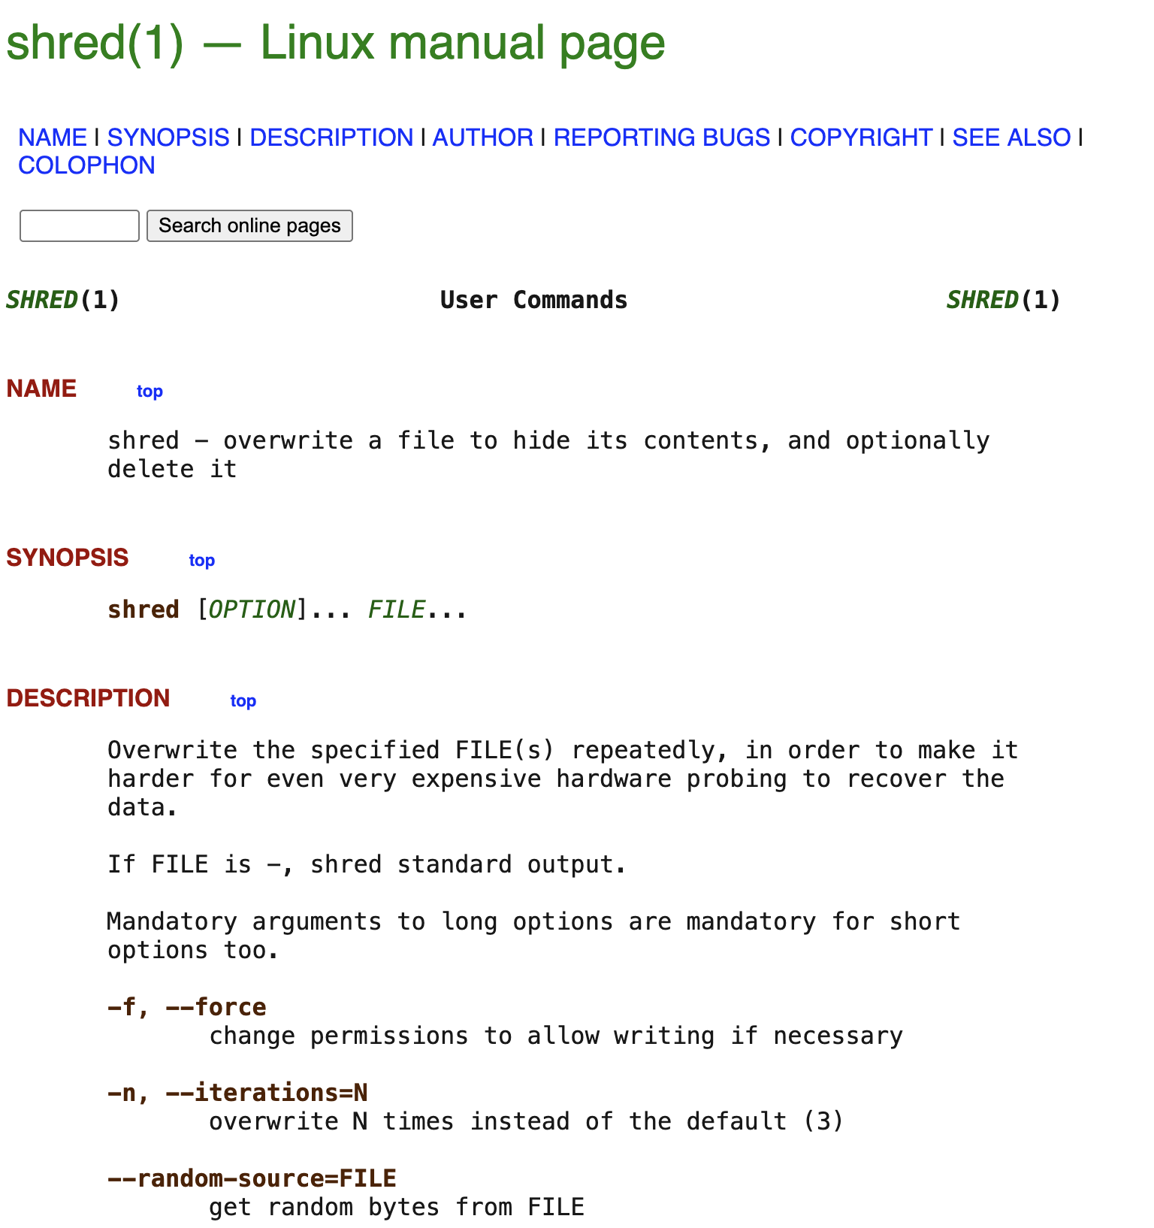
What about repurposing or disposal?
There is no “reset”-like functionality
  If you need a clean system, reimage it
Boot into a “live” image and use “shred” to erase

Slide 35
What about questions?

